Slide 1
Linked List (Singly)
Dr. Sifat Momen

Slide 2
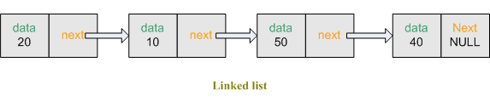
Linked List
One of the most fundamental Data Structures and can be used to implement many other data structures.
Linked list is comprised of nodes that are somehow linked to each other.
Each node has two parts:
Info (Data)
Address to the next node (link)

Slide 3
Linked List (Cont…)
Can you think of certain advantages and disadvantages of linked list over array?
Ask yourself this question again at the end of this lecture

Slide 4
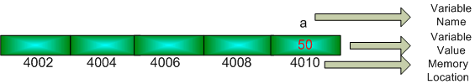
Pointer
To create a linked list in C/C++, we must have a clear understanding about pointer.
int a = 50; // create a variable a which has the value 50

Slide 5
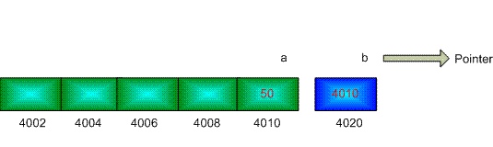
Pointer
int *b; // declare a pointer b
b = &a; // the unary operator & gives the address of an object
*b = 100;
cout << a

Slide 6
Array vs. Linked List
Linked list consists of multiple nodes where nodes are stored in a disjoint non-contiguous blocks of memory.
Array (on the other hand) is always stored in the memory as one contiguous block of memory.
This means that it might be difficult for the memory manager to extend the memory block if the programmer needs to extend the size of an array.
Assigning a large array size could also mean that much of the memory assigned is not used and hence rather wasted.
Therefore, it is impractical to use array when the size of the array is not known or easily guessable
Linked list, on the other hand can be easily expanded and contracted as required.

Slide 7
Array vs. Linked List
Can you describe how linked list may solve the problem that array has in terms of memory usage?
Instead of one contiguous blocks of memory in array, in a linked list a disjoint non-contiguous blocks of memory is obtained.
In order to link between the adjacent blocks, we need somehow to connect them
Consequently, for a node we need two things
Data
Address of the next block

Slide 8
Linked List
struct node
{
int data;
node *link;
};

Slide 9
So, what are the different operations you can do with linked list
For each different operations in a linked list, we will create separate function as part of the implementation towards it.
Insert node from the front
Insert node from the back
Insert after specified number of nodes
Traverse
Delete from back
Delete from front
Delete after specified number of nodes
Sort nodes
Print out nodes

Slide 10
Defining a node
struct node
{
int data;
node *link;
};

Slide 11
Creating the first node (head node)
node *head; // pointer to the head node
void init(int i){
head = NULL;
node *temp = new node(); // create a new node
temp->data = i; // set the data part
temp->link = NULL; // set the link part to null since it is not pointing to any other node
head = temp;
}
You may need to include the header file #include<cstddef> for NULL

Slide 12

Inserting a node at the back

Slide 13
Inserting a node at the back
_{void addNodeAtEnd(int i){}
node *temp = new node(); // create a new node
temp->data = i; // set the data part
temp->link = NULL; // set the address to which it links to as null
_{node *temp1 = head;}
while(temp1->link != NULL){ // traverse till the end
_{temp1 = temp1->link;}
}
temp1->link = temp; // set the address of last node to this node
}

Slide 14
Printing out all the nodes
void print(){
node *temp1 = head;
while(temp1->link != NULL){
cout << temp1->data << ", ";
temp1 = temp1->link;
}
cout << temp1->data << endl;
cout << endl;
}

Slide 15
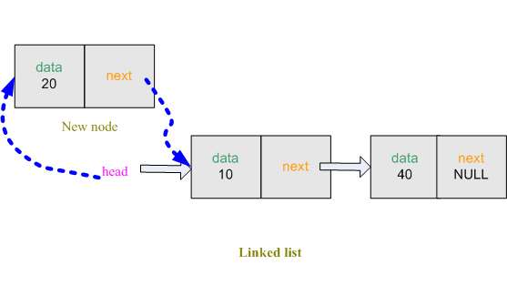
Inserting a node from the front

Slide 16
Inserting a node from the front
void addNodeFromFront(int i){
node *temp = new node(); // create a new node
temp->data = i; // set the data part
temp->link = head; // set the address part to which it links to is that of the head
head = temp; // the temp is now the new head
}

Slide 17
Main method
int main(){
init(2); // initialize a linked list with one node having the value 2
addNodeAtEnd(4); // insert a 4 at the end of the list
addNodeAtEnd(6); // insert a 6 at the end of the list
print(); // print out all the data values of the nodes
addNodeFromFront(8);
print();
return 0;
}

